Slide 1
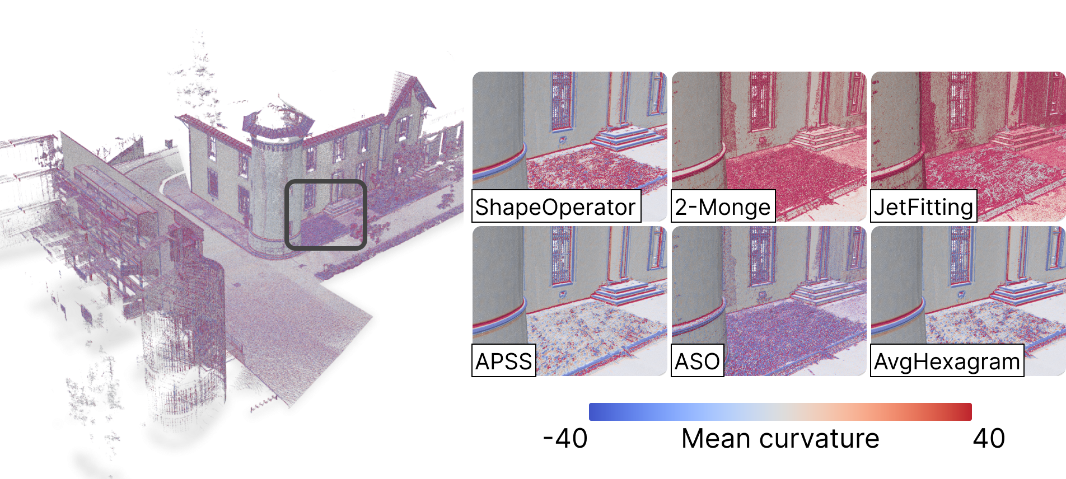
Survey on differential estimators for 3d point clouds

Slide 2

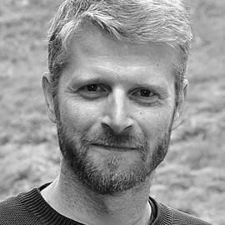




Survey on differential estimators for 3d point clouds
Léo Arnal--Anger¹,Thibault Lejemble², David Coeurjolly³, Loïc Barthe¹, Nicolas Mellado¹
¹ IRIT, Université de Toulouse, CNRS, Toulouse INP, UT, Toulouse, France
² Cerema, Toulouse, France
³ CNRS, Université Claude Bernard Lyon 1, INSA Lyon, LIRIS, France

Slide 3
Context
01

Slide 4
Context
Survey on differential estimators for 3d point clouds

Slide 5
Context
Survey on differential estimators for 3d point clouds

Slide 6
Context
Survey on differential estimators for 3d point clouds

Slide 7
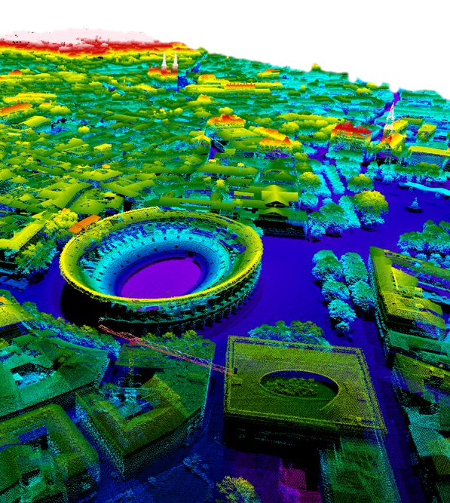
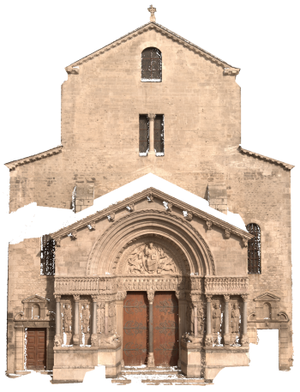

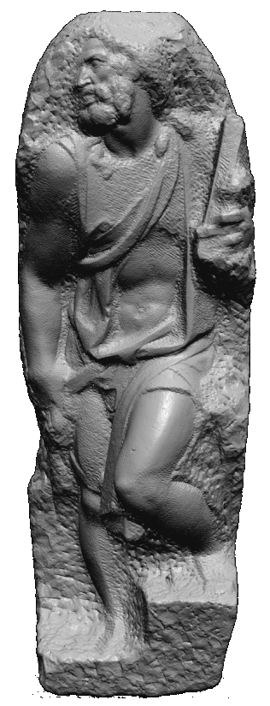
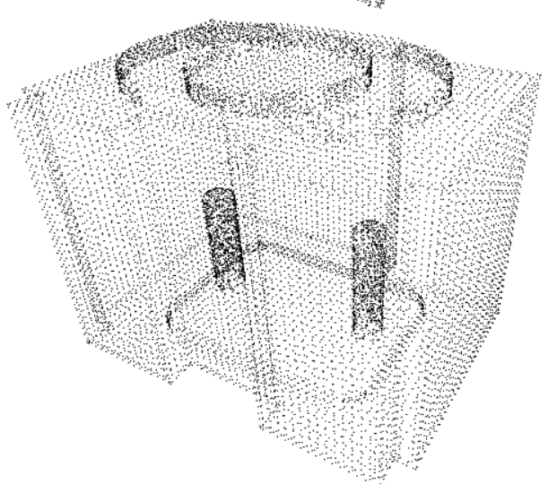
3D point clouds
Capture real world geometry
From real objects to virtual scenes

Slide 8
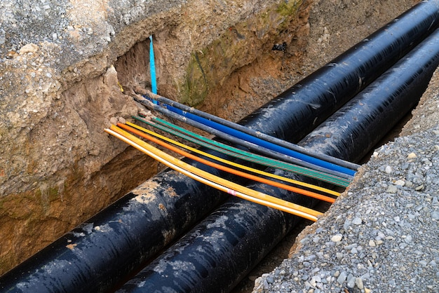
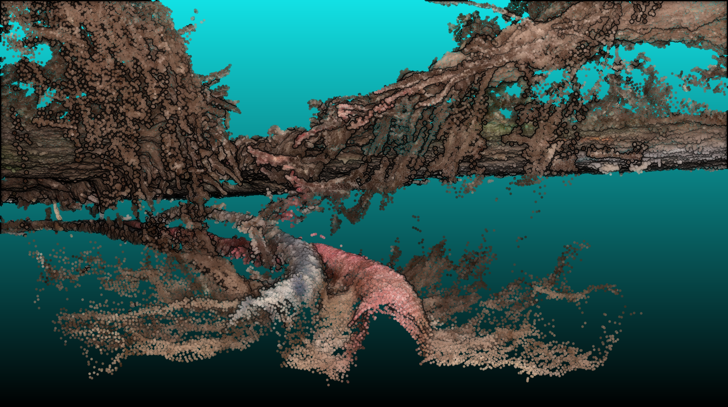
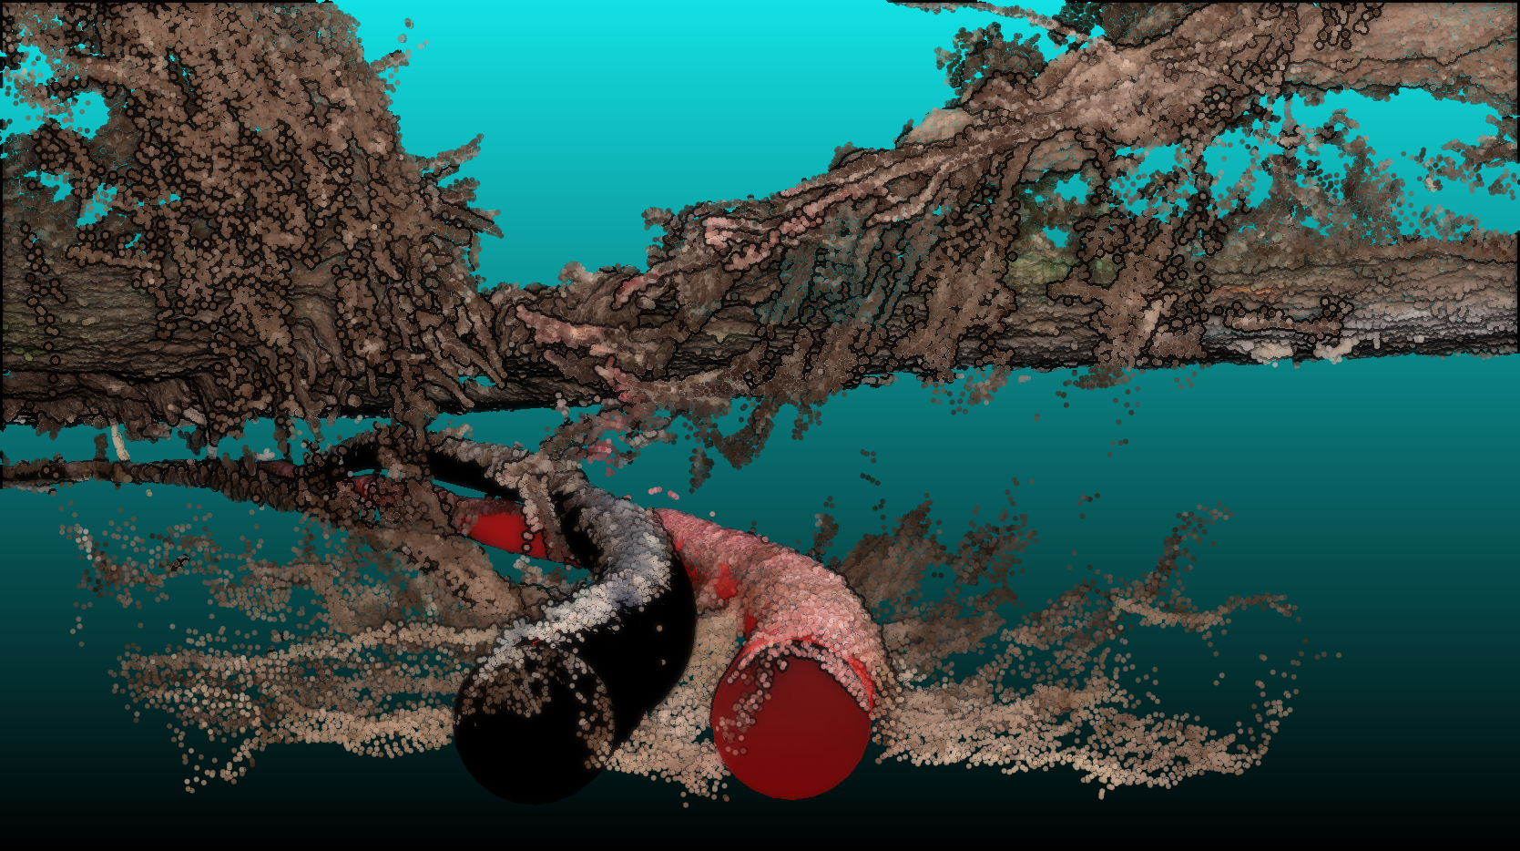
3D point clouds – Applications
Maintenance

Slide 9

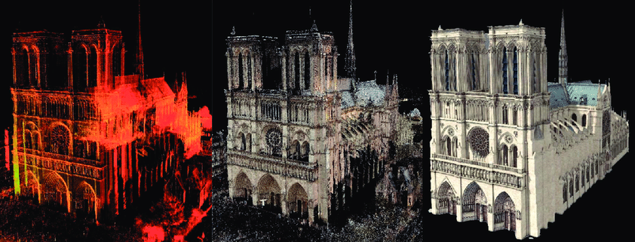
3D point clouds – Applications
Maintenance
Cultural Heritage

Slide 10
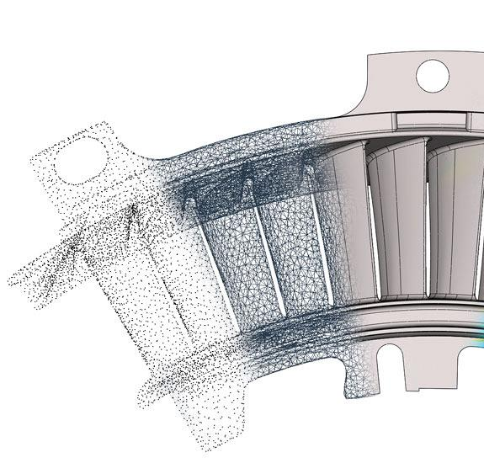
3D point clouds – Applications
Maintenance
Cultural Heritage
Reverse Engineering

Slide 11
3D point clouds – Applications
Maintenance
Cultural Heritage
Reverse Engineering
...
Toward 3D digital twins

Slide 12
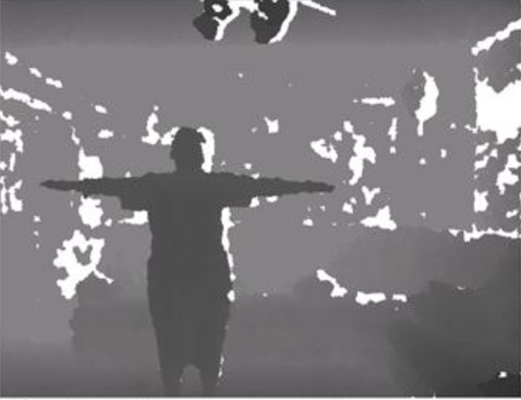
3D point clouds – Acquisition processes
Depth map (RGBD)

Slide 13
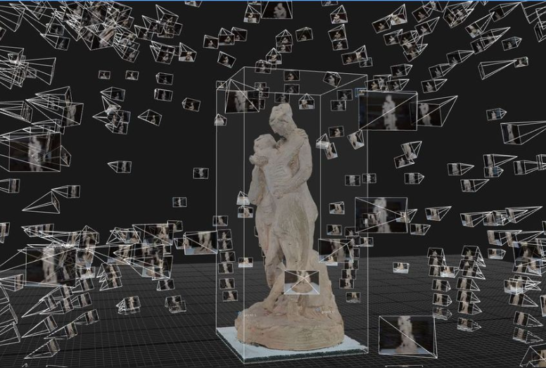
3D point clouds – Acquisition processes
Depth map (RGBD)
Photogrammetry

Slide 14
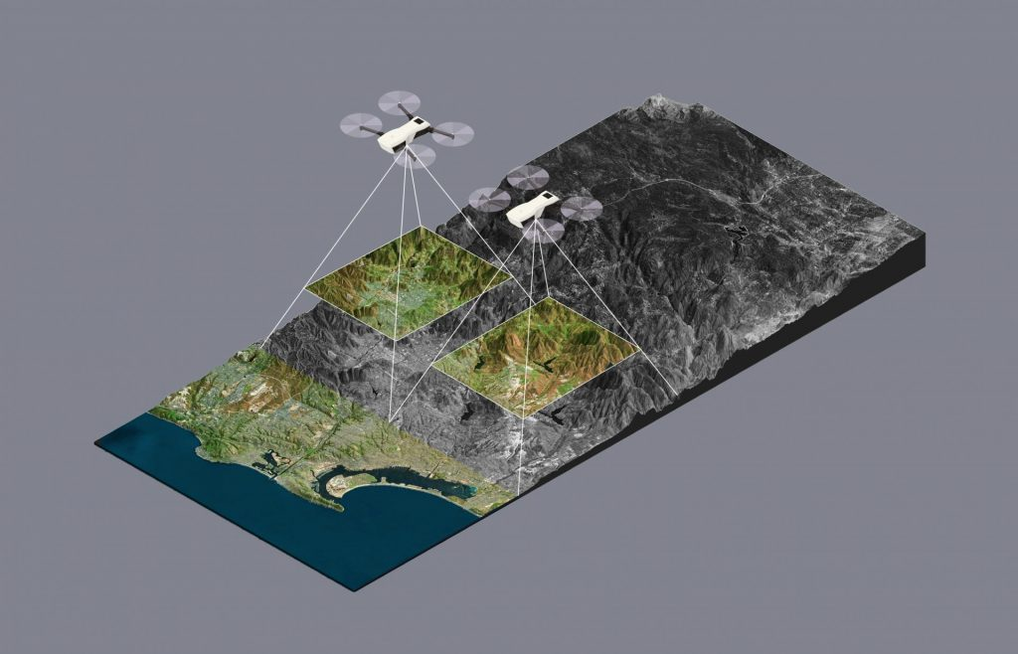
3D point clouds – Acquisition processes
Depth map (RGBD)
Photogrammetry

Slide 15
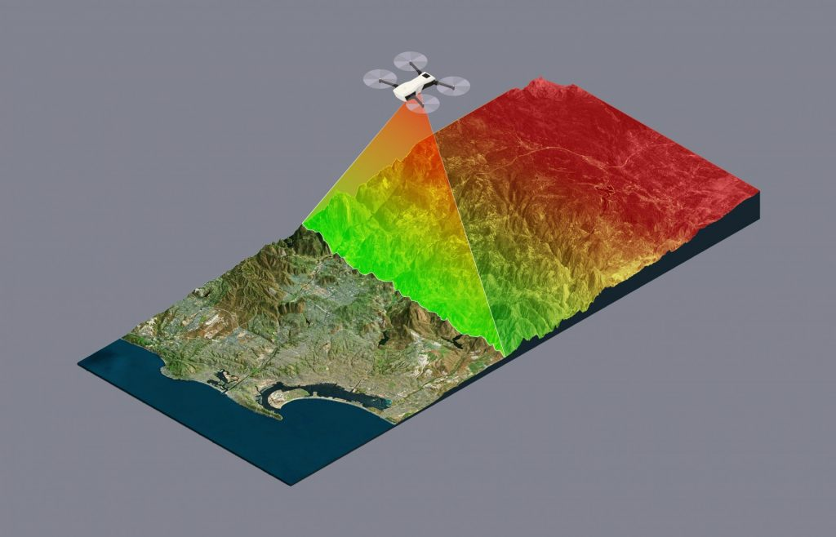
3D point clouds – Acquisition processes
Depth map (RGBD)
Photogrammetry
LiDAR

Slide 16
3D point clouds – Acquisition processes
Depth map (RGBD)
Photogrammetry
LiDAR
...

Slide 17
3D point clouds – Acquisition processes
Depth map (RGBD)
Photogrammetry
LiDAR
...

Slide 18
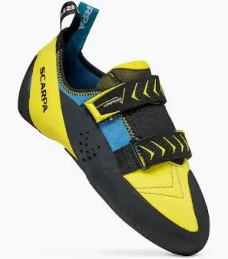
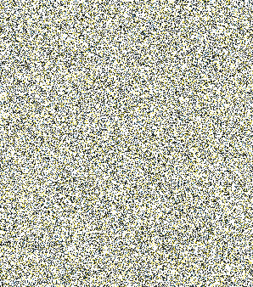
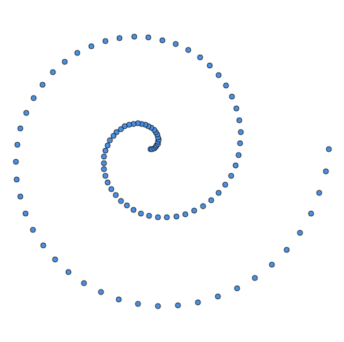

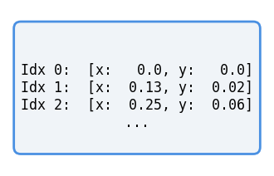
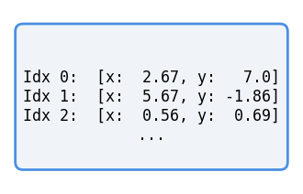


3D point clouds – Properties
permuted pixels
$$≠$$
Unordered data
$$=$$
permuted points
Notes:
Ici, bien noter que l’on n’est pas dans le cas 2D où l’on a une structure.
Si l’on enleve la structure pixel (qu’on modifie l’ordre) on voit bien que l’image est totalement différente.

Slide 19
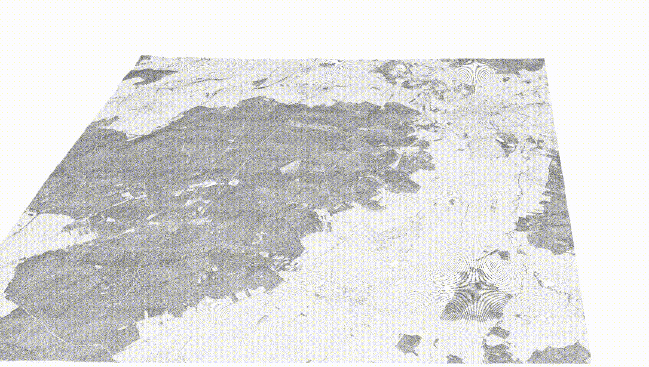
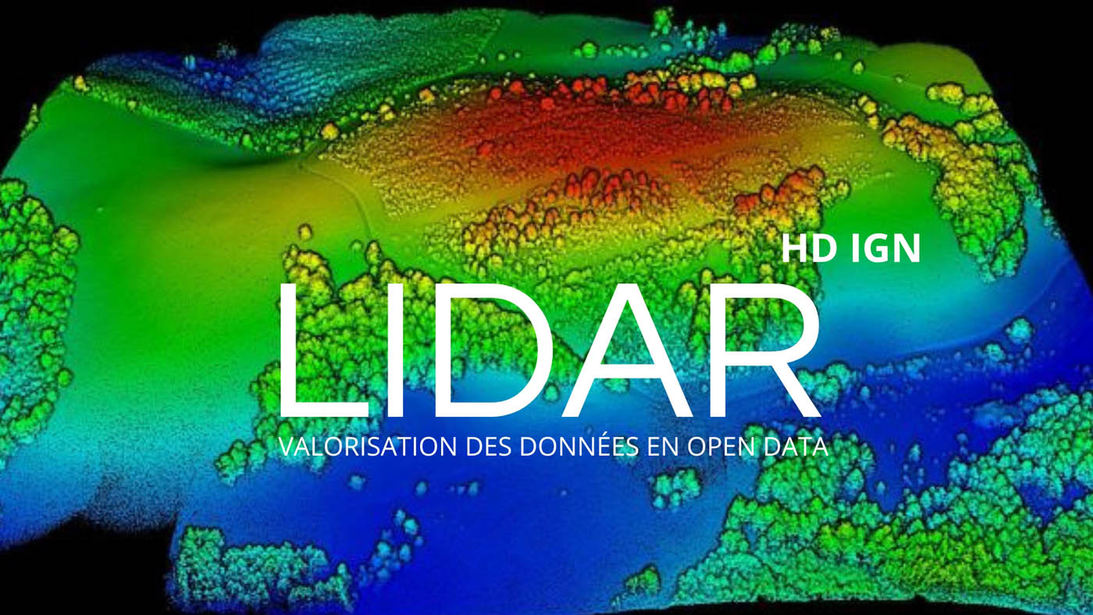
3D point clouds – Properties
Unordered data
Geometric complexity
Notes:
LiDAR precision

Slide 20
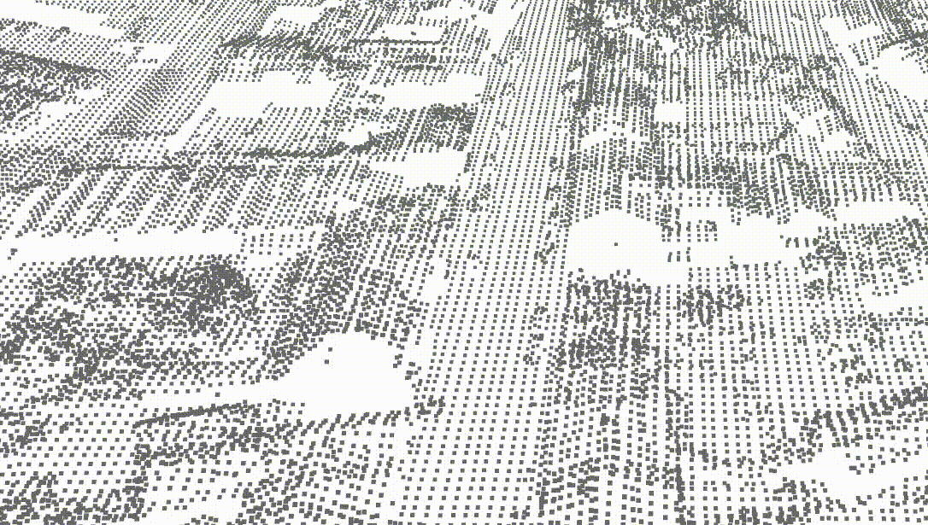
3D point clouds – Properties
Unordered data
Geometric complexity
Artefacts
  Sampling variation
  Measurement noise and outliers
  Registration errors
  Missing data (occlusions)
Notes:
LiDAR precision

Slide 21
3D point clouds – Acquired data
3D coordinates
Sensor positions
Attributes (depending on the acquisition process)
  Colors
  Intensity / Reflectivity
  Normal vectors (not captured but can be estimated)
  ...

Slide 22
Context
Survey on differential estimators for 3d point clouds

Slide 23
Context
Survey on differential estimators for 3d point clouds

Slide 24
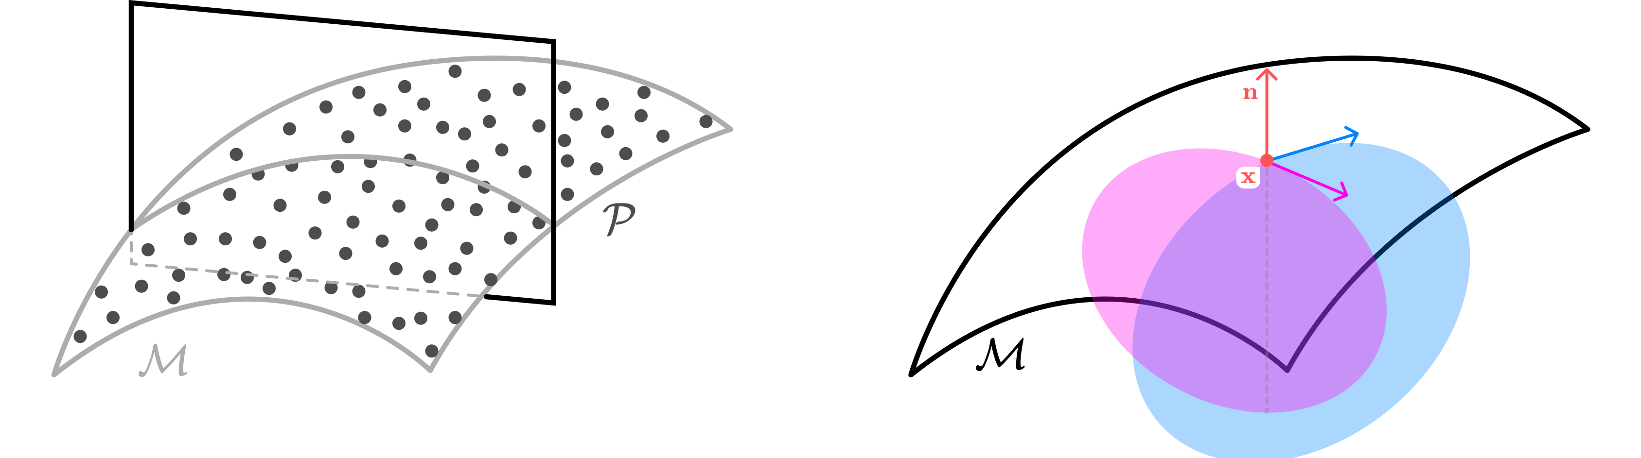
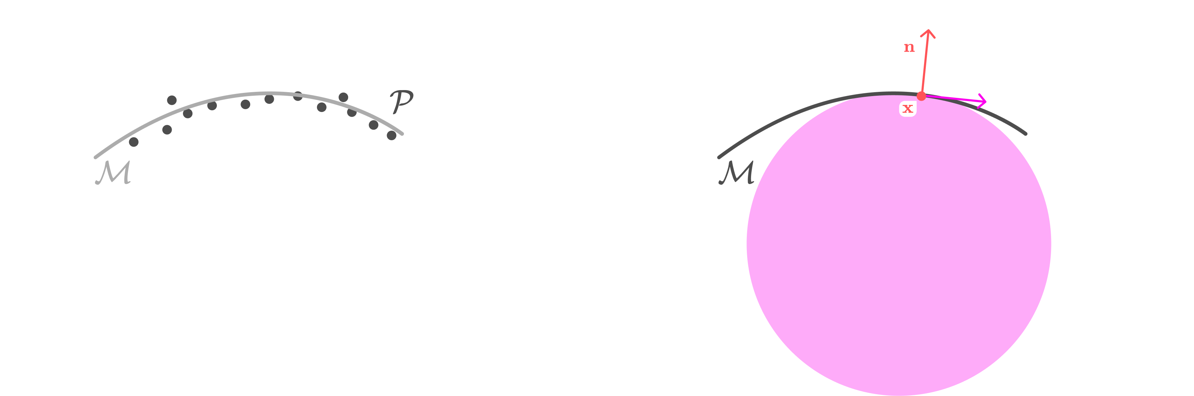

Differential
?
3D points sampling an unknown scanned smooth surface
Retrieve differential properties of the surface
ie. surface curvature

Slide 25
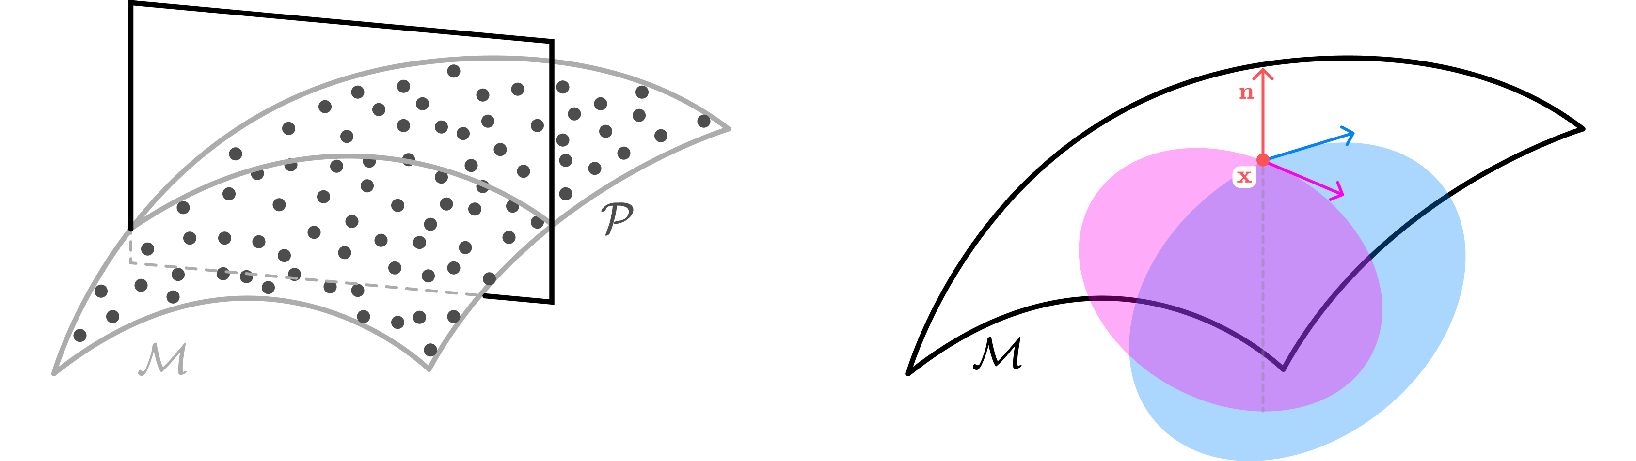
Differential
?
3D points sampling an unknown scanned smooth surface
Retrieve differential properties of the surface
ie. surface curvature

Slide 26
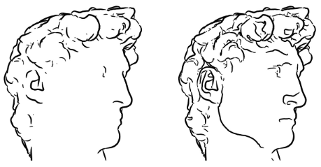
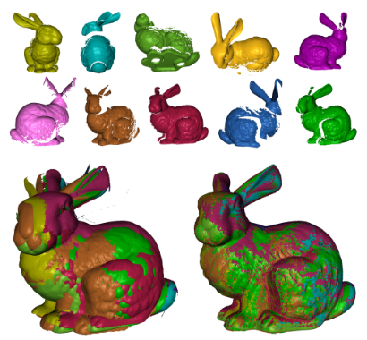
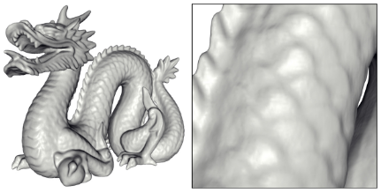
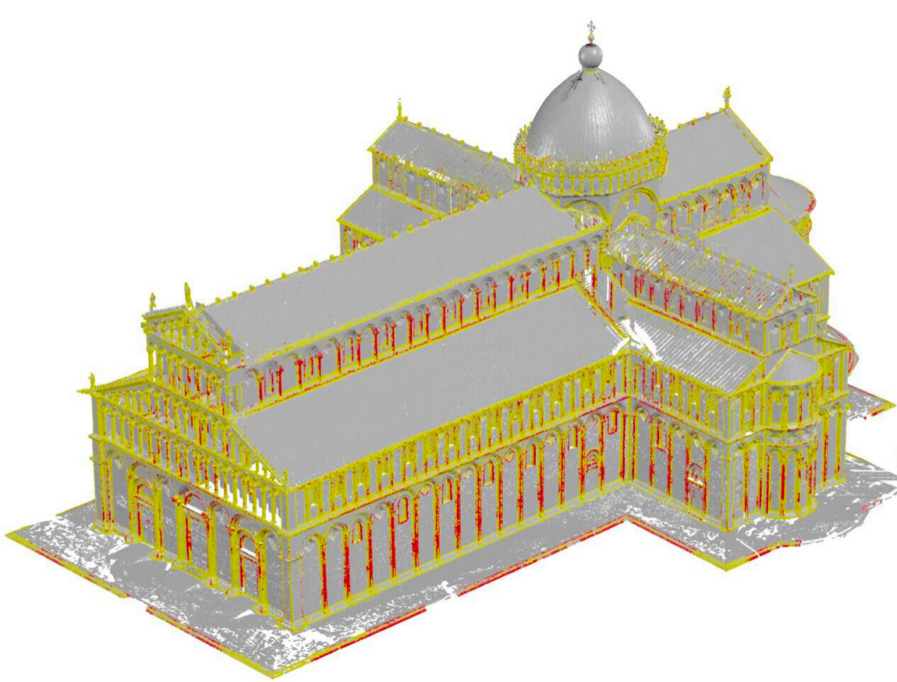
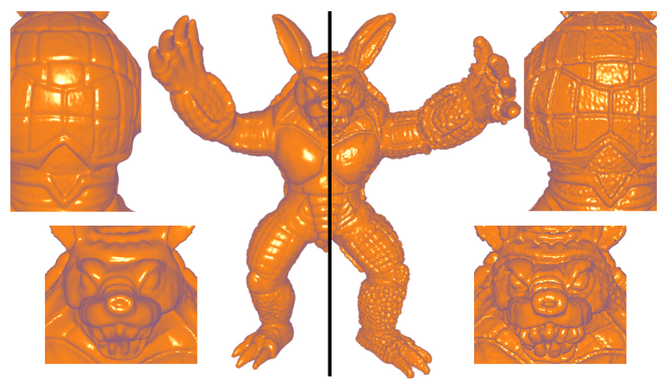
Differential – Usage Example
Registration [GMG*05]
Rendering [DFR*03]
Meshing [KBH06]
Classification [HLP*21]
Shape editing [BDC18]

Slide 27
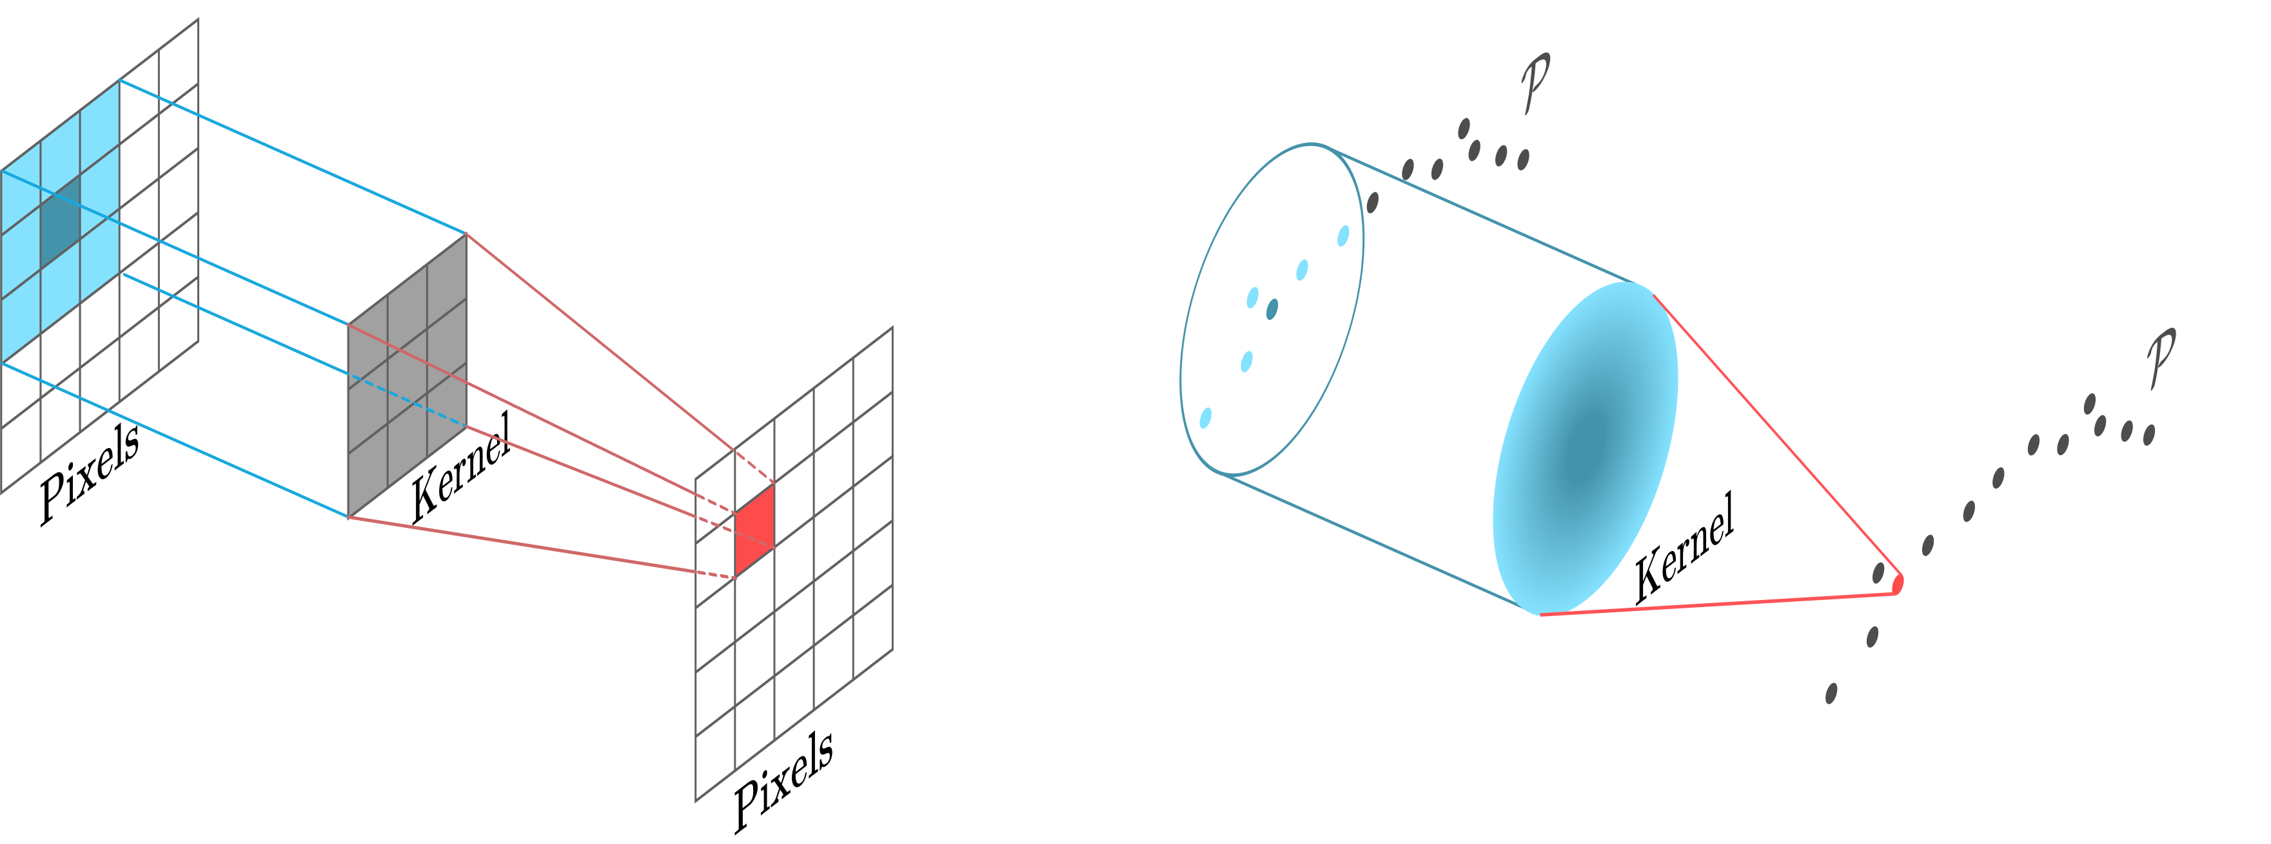
Differential – Intuitions
Image analogy: convolution and scale

Slide 28
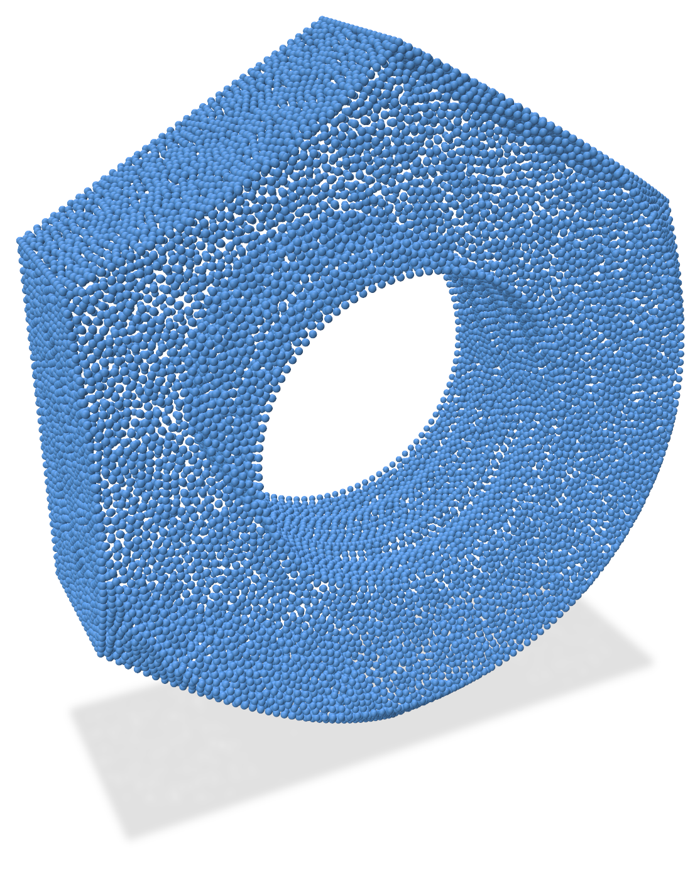
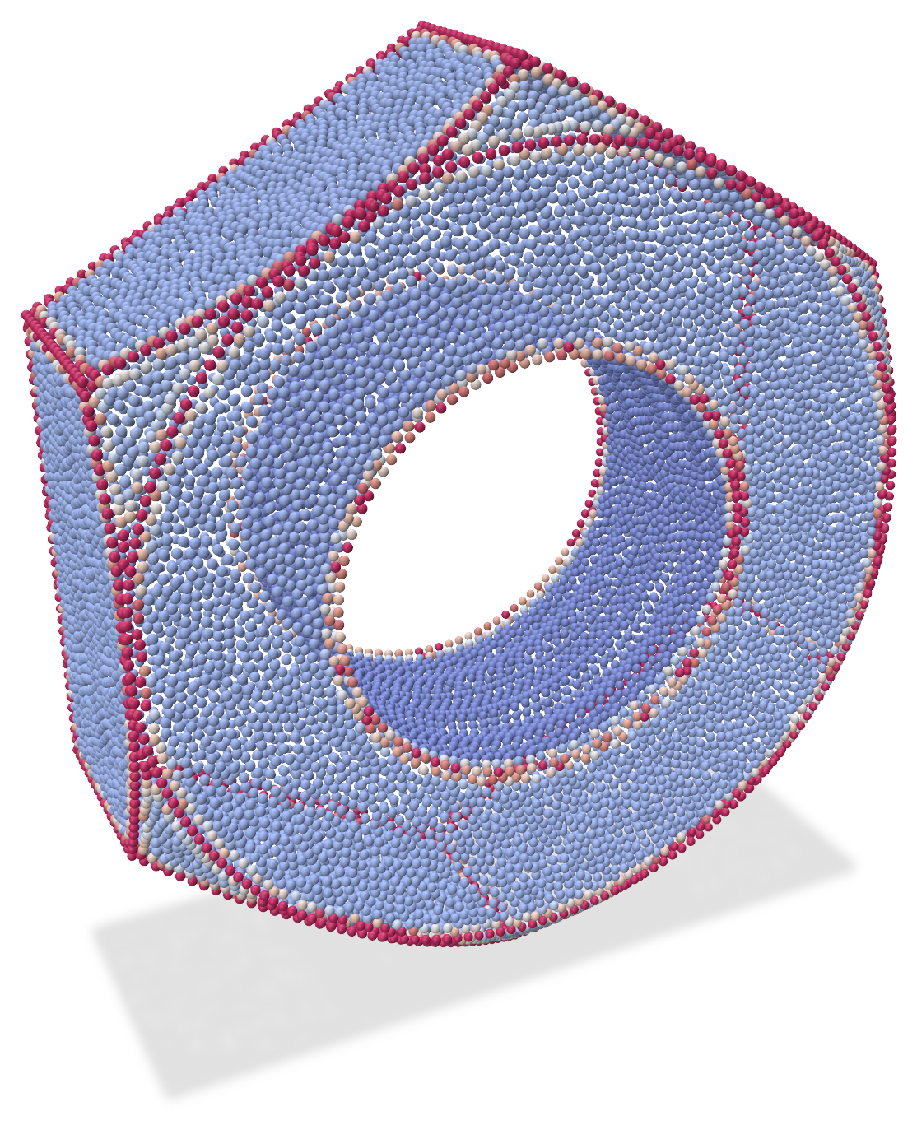
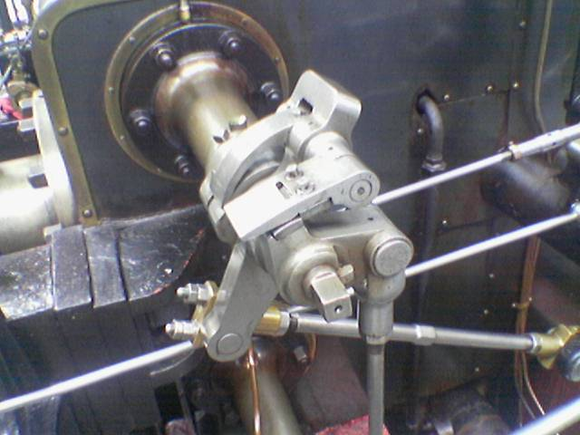
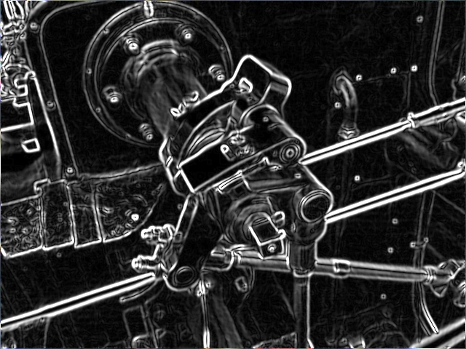
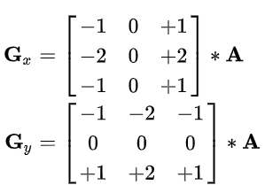

Differential – Intuitions
Example of contour detection
Sobel filter to compute 2D image gradients
Estimate mean curvature on 3D points

Slide 29
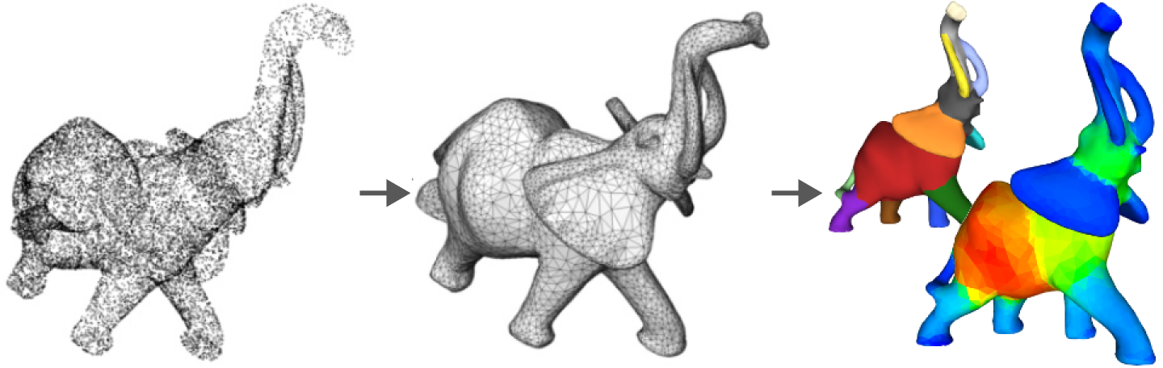
Differential – Mesh-based process
[CGAL]
point cloud
mesh
processing

Slide 30
Differential – Mesh-based process
[CGAL]
Alpha Shapes [EKS03]
Poisson Surface Reconstruction [KBH06]
Marching Cubes [LC98]
...
A survey of surface reconstruction from point clouds [BTS*17]
Mesh Statistics for Robust Curvature Estimation [VVP*16]
point cloud
mesh
processing
A survey of surface reconstruction from point clouds [BTS*17]
Mesh Statistics for Robust Curvature Estimation [VVP*16]

Slide 31
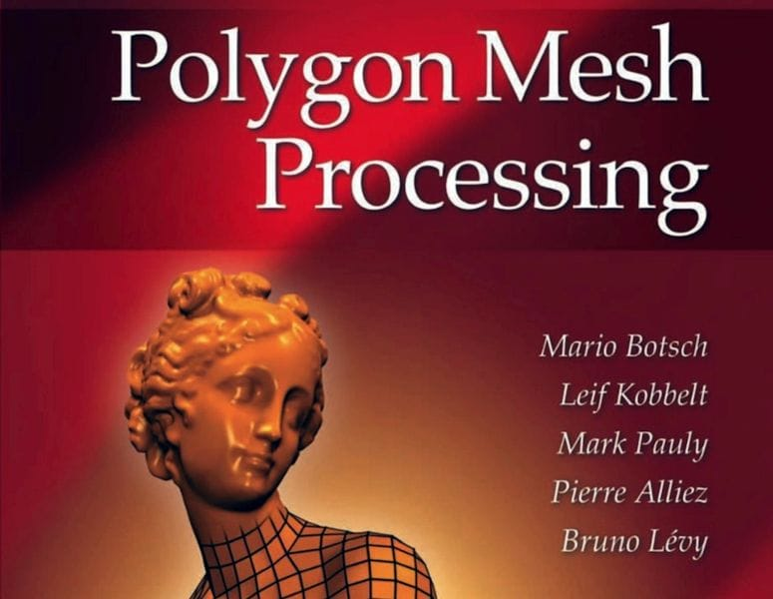
Differential – Mesh-based process
[CGAL]
point cloud
mesh
processing
A survey of surface reconstruction from point clouds [BTS*17]
Mesh Statistics for Robust Curvature Estimation [VVP*16]

Slide 32
Differential – Mesh-based process
[CGAL]
point cloud
mesh
processing
A survey of surface reconstruction from point clouds [BTS*17]
Mesh Statistics for Robust Curvature Estimation [VVP*16]
working on raw data

Slide 33
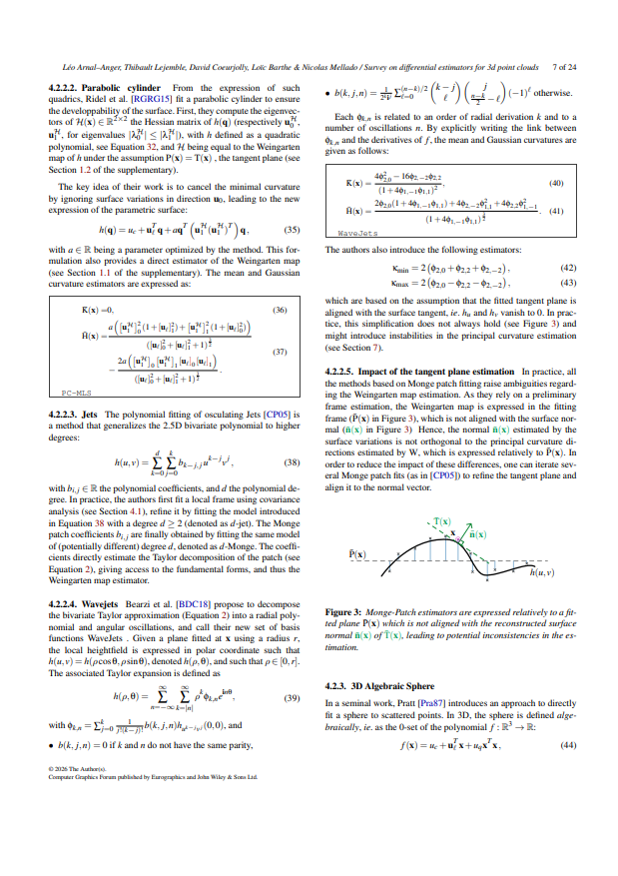
Context – Scope
Differential properties estimation in a raw 3D point cloud
Special focus on mathematical models
  with theoretical guarantees
  their use in Machine Learning models
Unified benchmark

Slide 34
PLAN
Context
Fundamentals
Methods
Benchmark
Future works
Conclusion
Notes:
Benchmark (benchmarking tools, benchmarking setting, take-away messages on short subset of the benchmark)

Slide 35
Fundamentals
02

Slide 36
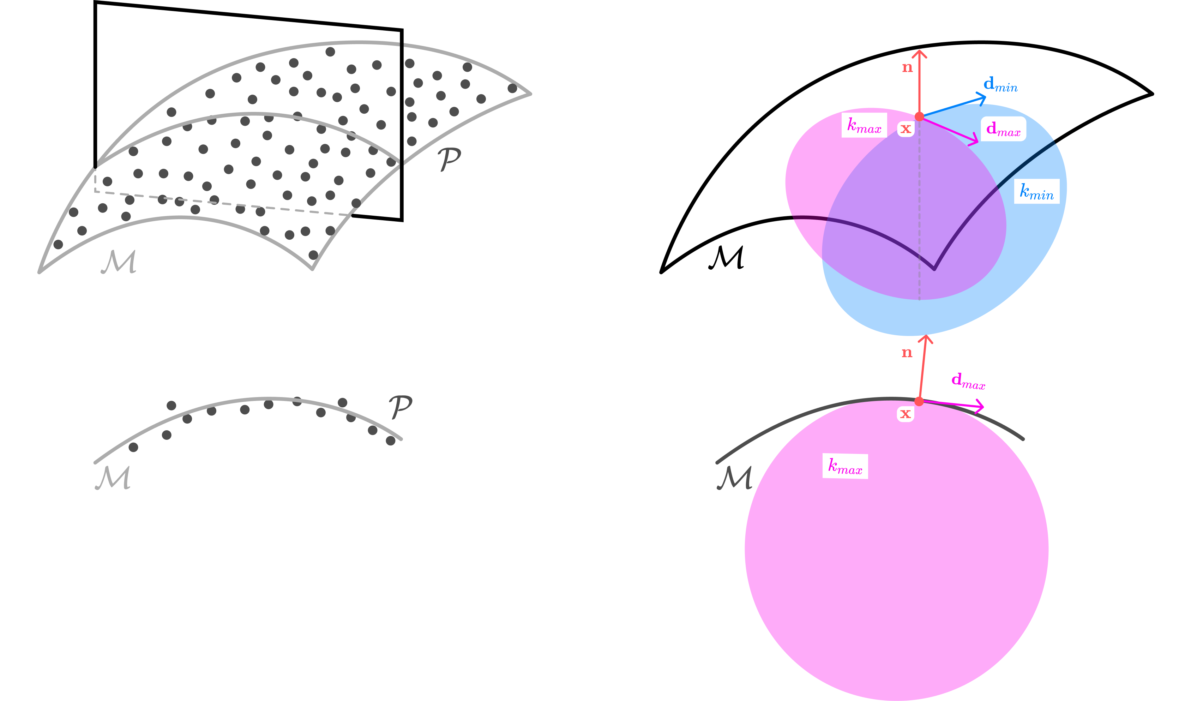
Fundamentals
?

Slide 37




Fundamentals
Normal
Tangent frame
Weingarten map
(principal curvature values and directions)
Mean curvature

Slide 38
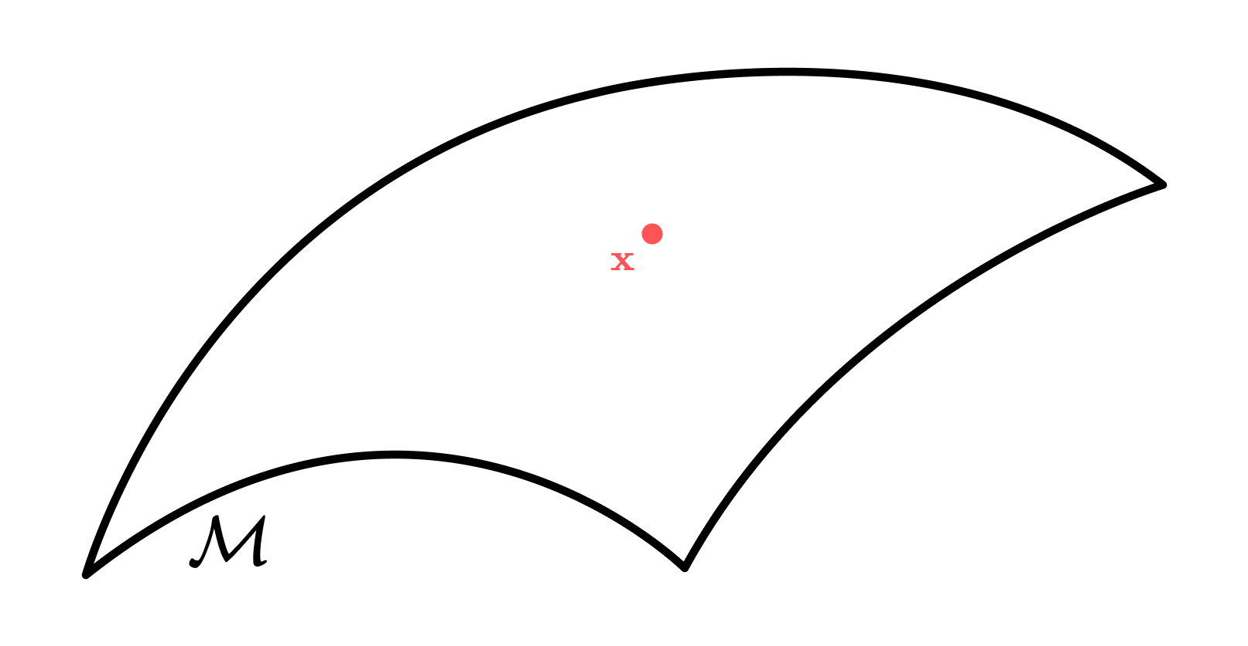

Normal vector
Given a surface M and a point x of interest

Slide 39
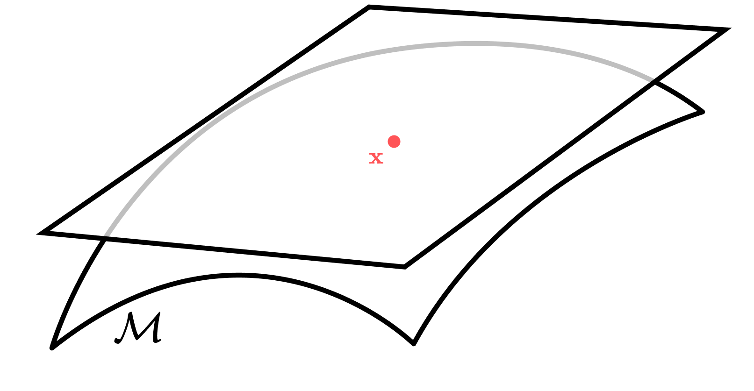
Normal vector
Given a surface M and a point x of interest
The tangent plane passing through x

Slide 40
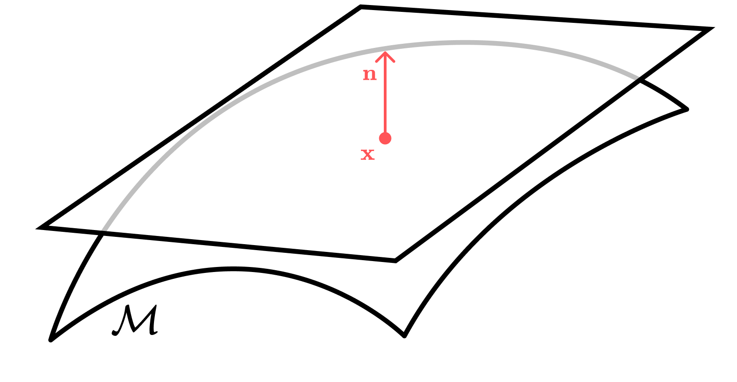
Normal vector
Given a surface M and a point x of interest
The tangent plane passing through x
  Orthogonal to the normal vector n

Slide 41
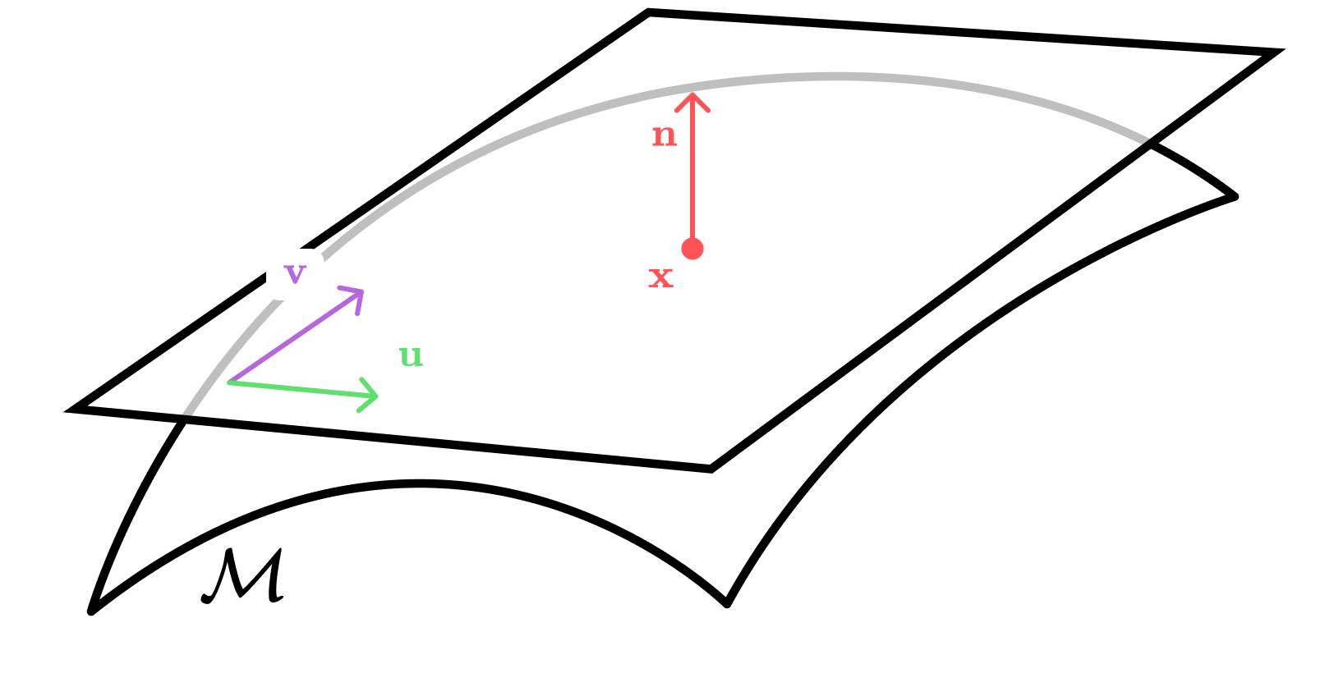
Tangent frame
u, v an orthogonal base of
the tangent frame

Slide 42
Tangent frame
u, v an orthogonal base of
the tangent frame
Let’s find a parametrisation of M

Slide 43
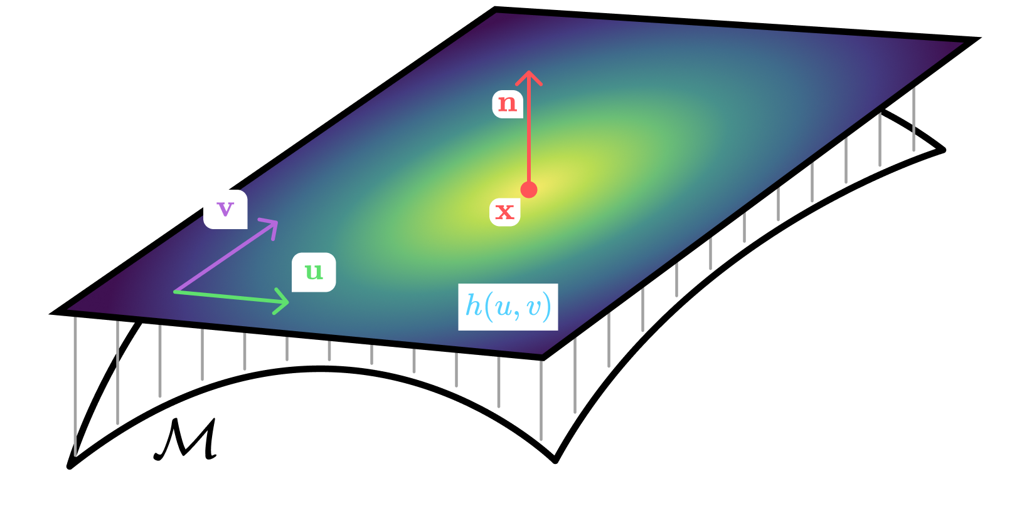
Tangent frame - parametrisation
h(u,v) the height field

Slide 44
Tangent frame - parametrisation
h(u,v) the height field
Note f(u,v,h(u,v))
the monge patch of M

Slide 45
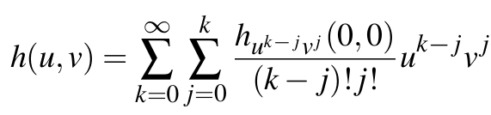
Tangent frame - parametrisation
h(u,v) the height field
Note f(u,v,h(u,v))
the monge patch of M
Notes:
In perfect settings, where h(u,v) is infinitely differentiable, it is possible thanks to the Taylor decomposition to note h(u,v) as the sum of the partial derivatives weighted by their corresponding coefficients.
And we want to observe the variations of the surface M thanks to the derivatives of the monge patch.

Slide 46
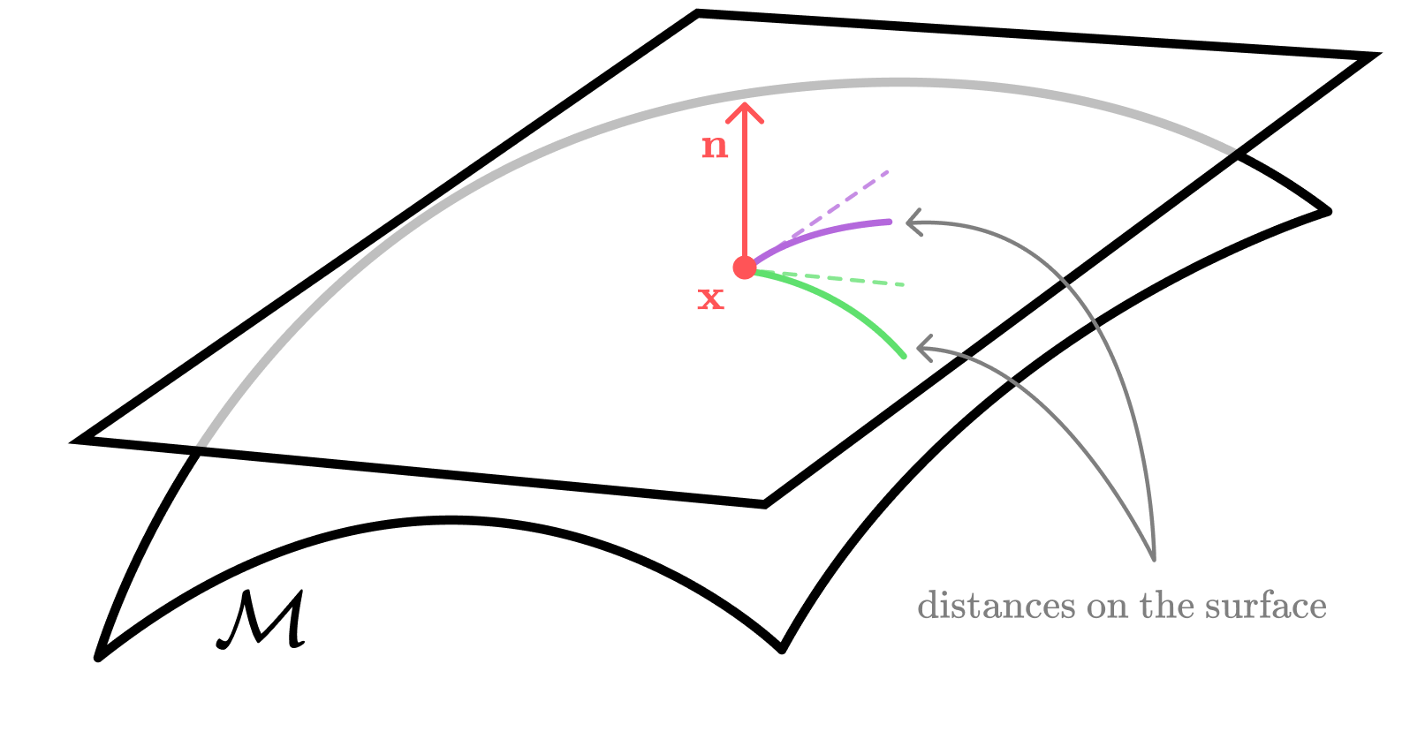
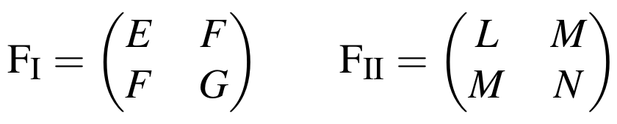
Tangent frame – Fundamental forms
The first fundamental form
  Intrinsic properties of the surface
Notes:
Observing the first derivatives leads to the first fundamental form.
Basically, this form gives the intrinsic properties of the surface.
Interestingly, if we observe here the partial derivative in one axe, for example in the u axe, we’re able to measure the distance on the surface.

Slide 47
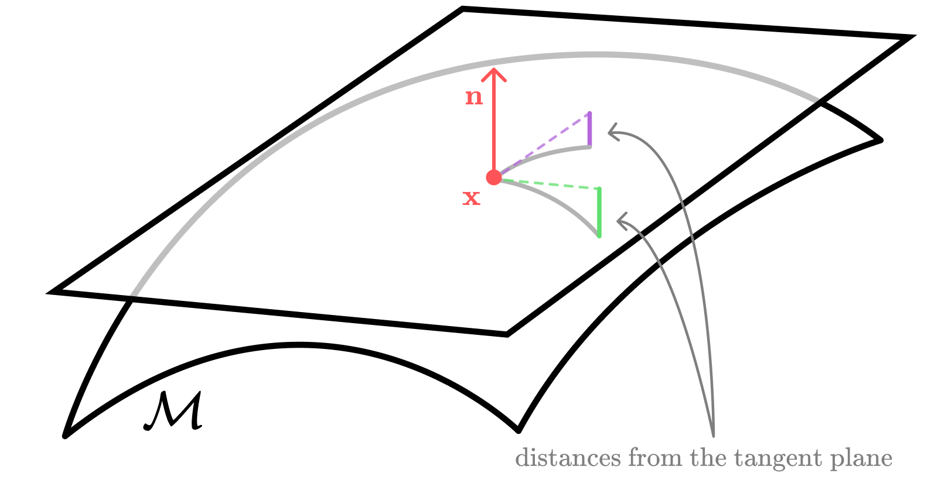
Tangent frame – Fundamental forms
The second fundamental form
  Extrinsic properties of the surface
Notes:
On the other hand, observing the second derivatives gives the second fundamental forms, where, combined with the previous fundamental form, correspond to all of our interest
Here, this second fundamental form gives the extrinsic properties of the surface.
In the same maner as previously mentionned, if we observe these derivatives in one axe, again, u, for example, it leads to measure the distances from the tangent plane.

Slide 48


Weingarten Map
Also called Shape Operator
Multiplication of the fundamental forms
Notes:
Now, since we have computed the first and second fundamental forms, we’re able to compute a super interesting tool : the weingarten map.
It is simple, this 2D matrix is the result of the multiplication of the second fundamental form with the inverse of the first one.
Ok, super fine, we have now a 2D matrix, but, why is it cool ?

Slide 49


Weingarten Map
Decomposition of the Weingarten map
W = U D U^{T}
U = $\begin{matrix}{(d}_{min} & d_{max}\end{matrix})$
D = $\left(\begin{matrix}k_{min} & 0 \\ 0 & k_{max}\end{matrix}\right)$
Notes:
Because, it stores the wanted principal curvatures !
By decomposing the Weingarten map using a principal component analysis, we’re extracting two things :
Two scalar values => The maximal and minimal curvature values.
Two vectors => The corresponding directions where the surface bends the most.

Slide 50


Weingarten Map – Other intuition
Derivatives of the Gaussian Map
  Observe the variations of normals

Slide 51


Mean Curvature
Averaging the principal curvatures
D

Slide 52

Mean Curvature
Directly with the partial derivatives of h

Slide 53

Fundamentals – Examples

Slide 54








Fundamentals – Examples
$$n$$
$$k_{min}$$
$$k_{max}$$
$$H$$
-7
curvature
7

Slide 55





Fundamentals – Examples
$$n$$
$$k_{min}$$
$$k_{max}$$
$$H$$
-10
curvature
10

Slide 56
QUESTION TIME

Slide 57
Context
Survey on differential estimators for 3d point clouds

Slide 58
Methods
03

Slide 59
Methods - Notations
Normal estimation
Tangent frame estimation
Weingarten map estimation
(principal curvature values and directions)
Mean curvature estimation

Slide 60

Methods – 2D example settings
In the following sections

Slide 61

Methods – 3D example settings
In the following sections

Slide 62

Methods - Overview
Direct point-based approaches
Local surface models
Measure theory approaches
1987
1990
1998
2014
2021
2024

Slide 63

Methods – Display convention
Methods presented today
Method1
[REF]
Method2
[REF]
Methods in the
survey/benchmark
year
year
year
year

Slide 64

Methods – Direct Point-Based Approaches
Statistical approaches
  Averages
  Covariance matrices
Mean
[PWY*07]
ShapeOperator
[KSNS07]
1990
1994
2007
2014

Slide 65


Methods – Mean
The barycenter is linked to the mean curvature [PWY*07]

Slide 66

Methods – Mean
Estimate
  Mean curvature

Slide 67
Methods – ShapeOperator [KSNS07]
Least-squares regression of the Weingarten Map
Maps 2D directions in the tangent plane to 2D normal variations

Slide 68


Methods – ShapeOperator [KSNS07]
Least-squares regression of the Weingarten Map
Maps 2D directions in the tangent plane to 2D normal variations
(position variation)
(normal variation)

Slide 69
Methods – ShapeOperator [KSNS07]
Estimate
  Weingarten Map
Requirements
  Oriented normal vectors

Slide 70

Methods – Direct Point-Based Approaches
Capture the geometry directly without reconstructing the explicit surface
1990
1994
2007
2014

Slide 71
Methods – Direct Point-Based Approaches
Pros
Cons
Simple formulas, efficient
Good to estimate principal directions
Noise sensitive
Lack of precision for curvature estimation (except for the ShapeOperator)

Slide 72

Methods – Local surface models
2.5D height field fitting
3D surface fitting
PCA
[HJ87]
2-Monge
[Gra98]
JetFitting
[CP05]
APSS [GG07]
ASO
[LCBM21]
1987
1998
2002
2005
2007
2013
2015
2018
2021

Slide 73


Methods – PCA [HJ87]
Find orthogonal directions of position’s variance

Slide 74
Methods – PCA [HJ87]
Find orthogonal directions of position’s variance
Tangent frame / normal estimation

Slide 75









Methods – PCA [HJ87]
Find orthogonal directions of position’s variance
Tangent frame / normal estimation
$$≤$$
$$≤$$
  eigenvalues (related to position’s variance)
  eigenvectors (normal and frame directions)

Slide 76



Methods – PCA [HJ87]
Find orthogonal directions of position’s variance
Tangent frame / normal estimation
$$≤$$
$$≤$$
  eigenvalues (related to position’s variance)
  eigenvectors (normal and frame directions)

Slide 77

Methods – PCA [HJ87]
Find orthogonal directions of position’s variance
Tangent frame / normal estimation [HJ87]
  eigenvalues (related to position’s variance)
  eigenvectors (normal and frame directions)

Slide 78

Methods – PCA [HJ87]
Analysis of the eigenvalues
  Not related to curvatures
  Over-estimate the curvatures
  eigenvalues (related to position’s variance)
  eigenvectors (normal and frame directions)

Slide 79

Methods – PCA [HJ87]
Analysis of the eigenvalues
  Not related to curvatures
  Over-estimate the curvatures
Ground-truth curvatures
  eigenvalues (related to position’s variance)
  eigenvectors (normal and frame directions)

Slide 80

Methods – 2-Monge [Gra98]
Monge patch fitting
  2nd order bivariate polynomial

Slide 81


Methods – 2-Monge [Gra98]
Monge patch fitting
  2nd order bivariate polynomial
height to the plane
2D point coordinates

Slide 82

Methods – 2-Monge [Gra98]
Monge patch fitting
  2nd order bivariate polynomial
height to the plane
2D point coordinates

Slide 83

Methods – 2-Monge [Gra98]
Monge patch fitting
  2nd order bivariate polynomial
height to the plane
2D point coordinates

Slide 84
Methods – 2-Monge [Gra98]
Monge patch fitting
  2nd order bivariate polynomial
height to the plane
2D point coordinates

Slide 85

Methods – 2-Monge [Gra98]
Monge patch fitting
  2nd order bivariate polynomial
height to the plane
2D point coordinates

Slide 86

Methods – 2-Monge [Gra98]
Estimate
  Weingarten Map
Requirements
  Initial tangent frame

Slide 87
Methods – JetFitting [CP05]
Monge patch fitting
  Higher order bivariate polynomial
Normal refinement

Slide 88

Methods – JetFitting [CP05]
Monge patch fitting
  Higher order bivariate polynomial
Normal refinement

Slide 89

Methods – JetFitting [CP05]
Monge patch fitting
  Higher order bivariate polynomial
Normal refinement

Slide 90

Methods – JetFitting [CP05]
Monge patch fitting
  Higher order bivariate polynomial
Normal refinement

Slide 91
Methods – JetFitting [CP05]
Estimate
  Weingarten Map
Requirements
  Initial tangent frame

Slide 92

Methods – JetFitting [CP05]
Estimate
  Weingarten Map
Requirements
  Initial tangent frame

Slide 93

Methods – APSS [GG07]
Algebraic sphere fitting
Based on Pratt’s work [Pra87]
Closed-form formulation

Slide 94

Methods – APSS [GG07]
Algebraic sphere fitting
Based on Pratt’s work [Pra87]
Closed-form formulation

Slide 95
Methods – APSS [GG07]
Algebraic sphere fitting
Based on Pratt’s work [Pra87]
Closed-form formulation

Slide 96

Methods – APSS [GG07]
Algebraic sphere fitting
Based on Pratt’s work [Pra87]
Closed-form formulation
Second-order derivative
  $∇^{2} S\left(x\right)= 2 u_{q}$

Slide 97


Methods – APSS [GG07]
Algebraic sphere fitting
Based on Pratt’s work [Pra87]
Closed-form formulation
Second-order derivative
  $∇^{2} S\left(x\right)= 2 u_{q}$
  Mean curvature

Slide 98

Methods – APSS [GG07]
Estimate
  Mean curvature H
Requirements
  Input normals
Other sphere fitting variants
  3D positions only [Pra87]
  non-oriented normals [CGBG13]

Slide 99
Methods – ASO [LCBM21]
Extension to the APSS for Weingarten Map estimation
Notes:
Discours:
« On peut voir la méthode d’estimation de la courbure moyenne via APSS
comme le résultat de la différentiation de sa formule, ou autrement dit, le gradient de sa 0-isosurface.
Si maintenant on considère une SDF reconstruite via la méthode des MLS (pas détaillée ici).
L’observation de la variation des normales sur cette surface mène à la Weingarten Map »

Slide 100

Methods – ASO [LCBM21]
Extension to the APSS for Weingarten Map estimation
Weight kernel differentiation
  Variations of the normals on
  the estimated surface
Notes:
Discours:
« On peut voir la méthode d’estimation de la courbure moyenne via APSS
comme le résultat de la différentiation de sa formule, ou autrement dit, le gradient de sa 0-isosurface.
Si maintenant on considère une SDF reconstruite via la méthode des MLS (pas détaillée ici).
L’observation de la variation des normales sur cette surface mène à la Weingarten Map »

Slide 101
Methods – ASO [LCBM21]
Difference between APSS and ASO
Notes:
Discours:
« On peut voir la méthode d’estimation de la courbure moyenne via APSS
comme le résultat de la différentiation de sa formule, ou autrement dit, le gradient de sa 0-isosurface.
Si maintenant on considère une SDF reconstruite via la méthode des MLS (pas détaillée ici).
L’observation de la variation des normales sur cette surface mène à la Weingarten Map »

Slide 102

Methods – ASO [LCBM21]
Estimate
  Weingarten Map
Requirements
  Oriented normals

Slide 103
Methods – Local surface models
Analytic curvature estimation through geometric primitive fitting
1987
1998
2002
2005
2007
2013
2015
2018
2021

Slide 104
Methods – Local surface models
Pros
Cons
Stable
« Gold standard » on perfect data (JetFitting)
3D methods avoid the two pass fitting (using tangent plane)
2.5D methods : Tangent plane -dependent
The more the order of the primitive is, the more it tends to overfit the noise
May be slower than direct point-based approaches

Slide 105

Methods – Measure theory approaches
Geometric Measure Theory
AvgHexagram
[LCL*23]
2022
2023

Slide 106



Methods – AvgHexagram [LCL*23]
Based on normal cycles [CSM03]
Summations over locally generated triangles {i,j,k}

Slide 107




Methods – AvgHexagram [LCL*23]
Generation of the triangles in different ways

Slide 108
Methods – AvgHexagram [LCL*23]
Generation of the triangles in different ways

Slide 109
Methods – AvgHexagram [LCL*23]
Generation of the triangles in different ways

Slide 110
Methods – AvgHexagram [LCL*23]
Generation of the triangles in different ways

Slide 111

Methods – AvgHexagram [LCL*23]
Estimate
  Weingarten Map
Requirements
  Oriented normals

Slide 112
Methods – Measure theory approaches
Define curvatures as measures on the bundle {x,n}
2022
2023

Slide 113
Methods – Measure theory approaches
Pros
Cons
Theoretical guarantees (convergence and stability)
Robustness to noise position
AvgHexagram time-efficient
Normal dependent

Slide 114
Methods – Overview
What about Machine Learning approaches?
1987
1990
1998
2014
2021
2024

Slide 115

Methods – Overview
Machine learning approaches
2016
2025

Slide 116
Methods – Machine learning approaches
Regression-based
  Learn features on the point cloud directly
[BM16, QSMG17, GKOM18, ZNZ*25]

Slide 117
Methods – Machine learning approaches
Weight estimation
  Offset points [ZLD*21, LZW*22, ZJW*23]
  Weights [LOM20, BSG20, ZLD*21, ZJW*23]
  Primitive fitting (plane or jet)

Slide 118
Methods – Machine learning approaches
Local surface estimation
  Differential RANSAC model [CZB*22]
  Hypersurface fitting on the feature space
[LLC*22, LFS*23]
  Derivatives of implicit surface [LSY24]

Slide 119
Methods – Machine learning approaches
Most of these are dedicated (but not limited) to normal estimation
The better ones often rely on classical primitive fitting
  Plane [LOM20]

Slide 120
Methods – Machine learning approaches
Most of these are dedicated (but not limited) to normal estimation
The better ones often rely on classical primitive fitting
  Plane [LOM20]
  JetFitting [BSG20, ZLD*21, ZJW*23]

Slide 121
Methods – Machine learning approaches
Most of these are dedicated (but not limited) to normal estimation
The better ones often rely on classical primitive fitting
  Plane [LOM20]
  JetFitting [BSG20, ZLD*21, ZJW*23]
Why choose these primitive instead of others?
?

Slide 122
QUESTION TIME

Slide 123

What’s under the rug?

Slide 124

What’s under the rug? – Weighting schemes
Neighborhood weighting kernels

Slide 125

What’s under the rug? – Neighborhood collection
Neighborhood weighting kernels
Neighborhood collection

Slide 126
Benchmark
04

Slide 127

Benchmark
Benchmark ecosystem
  Datasets
  Quantitative analysis tools
  Qualitative analysis tools
  Visualization
  Website
Link to the website

Slide 128
Benchmark
Benchmark ecosystem
  Datasets
  Quantitative analysis tools
  Qualitative analysis tools
  Visualization
  Website
Open
Open
Open
Open
Open
Link to the website

Slide 129
Benchmark
Estimators
  Ponca [MLG∗20] (also for kD-Tree)
  CGAL [PC24] for JetFitting
  Eigen for the maths
Visualization tools
  Polyscope
Dataset generation
  DGtal [DGt]
  Helios++ [WEW*22] for LiDAR-like noise
Link to the website

Slide 130

Benchmark - Datasets
Artifacts
Geometrical complexity

Slide 131



Base of our benchmarking tool
Samples of implicit polynomial surfaces
  Generated with DGtal [DGt]
Ground-truth
  Weingarten maps
Datasets – DGtal

Slide 132



Coming from the ABC dataset [KMJ*19]
Sampled from the meshes
  Poisson disk sampling [Yuk15]
Ground-truth
  Normals
Datasets – CAD

Slide 133






LiDAR-like density variation
  Helios++ [WEW*22]
Over the DGtal dataset
Over the ABC dataset
Datasets – Helios

Slide 134

Datasets – Helios

Slide 135



Widely used in deep learning
Test set of PCPNet Dataset
Ground-truth
  (mesh-estimated) curvatures
  Normals
Datasets – PCPNet

Slide 136
Used for qualitative evaluation
Rohbau3D [RB25]
OpenTrench3D [HJP∗24]
Semantic3D [HSL∗17]
PCA-estimated normals
  Z-oriented
Datasets – Real World

Slide 137

Datasets – Perturbations

Slide 138
Benchmark – Evaluation
Metrics
  RMSE
  RMS Angular E

Slide 139


DGtal dataset (left)
  Clean data (no noise)
  50 000pts per shape
DGtal + Helios dataset (right)
  No added noise
  Density variation with Helios
Benchmark – Settings

Slide 140

Results and take away messages

Slide 141

Results and take away messages

Slide 142

Results and take away messages

Slide 143

Results and take away messages

Slide 144


Results and take away messages

Slide 145
Results and take away messages

Slide 146
Future works
05

Slide 147
Future works
Deeper analysis of the dependence on normals and orientation
Unified benchmark including deep learning and ‘classical’ approaches
Include prior knowledge of sensors
Higher order differential properties

Slide 148
Conclusion
06

Slide 149
Summary
Survey of differential estimators on 3d point cloud
Open source benchmark
  Several datasets
  Ecosystem (data analysis, evaluation, website)
Results
  No « best » method
  Depends on radius, type of surface, differential property, input requirements ...
  Direct point-based approaches
  Local surface models
  Measure theory approaches
  Machine learning approaches

Slide 150
Thanks!
storm-irit.github.io/pcloud-differential-estimation-benchmark-website

Slide 151

Thanks!
Léo is looking for a post doc!

Slide 152
Bibliography
[BKP∗10] BOTSCH M., KOBBELT L., PAULY M., ALLIEZ P., LEVY B.: Polygon Mesh Processing. A K Peters, 2010. doi:10.1201/ b10688.
[VVP∗16] VÁŠA L., VANˇ Eˇ CEK P., PRANTL M., SKORKOVSKÁ V., MARTÍNEK P., KOLINGEROVÁ I.: Mesh Statistics for Robust Curvature Estimation. Computer Graphics Forum (2016). doi:10.1111/ cgf.12982.
[BTS∗17] BERGER M., TAGLIASACCHI A., SEVERSKY L. M., ALLIEZ P., GUENNEBAUD G., LEVINE J. A., SHARF A., SILVA C. T.: A survey of surface reconstruction from point clouds. Computer Graphics Forum 36 (2017). doi:10.1111/cgf.12802.
[Gra98] GRAY A.: Modern differential geometry of curves and surfaces with mathematica (second edition). Computers & Mathematics with Applications 36 (1998). doi:10.1016/s0898-1221(98)91133-6.
[KSNS07] KALOGERAKIS E., SIMARI P., NOWROUZEZAHRAI D., SINGH K.: Robust Statistical Estimation of Curvature on Discretized Surfaces. In Geometry Processing (2007), Belyaev A., Garland M., (Eds.), The Eurographics Association. doi:/10.2312/SGP/SGP07/013-022.
[LCBM21] LEJEMBLE T., COEURJOLLY D., BARTHE L., MELLADO N.: Stable and efficient differential estimators on oriented point clouds. Computer Graphics Forum 40 (8 2021), 205–216. doi:10.1111/ CGF.14368.
[PWY∗07] POTTMANN H., WALLNER J., YANG Y. L., LAI Y. K., HU S. M.: Principal curvatures from the integral invariant viewpoint. Computer Aided Geometric Design 24 (11 2007), 428–442. doi:10.1016/J.CAGD.2007.07.004.
[HJ87] HOFFMAN R., JAIN A. K.: Segmentation and classification of range images. IEEE Transactions on Pattern Analysis and Machine Intelligence PAMI-9, 5 (1987), 608–620. doi:10.1109/TPAMI.1987.4767955.
[CP05] CAZALS F., POUGET M.: Estimating differential quantities using polynomial fitting of osculating jets. Computer Aided Geometric Design 22 (2 2005), 121–146. doi:10.1016/J.CAGD.2004.09.004.
[Pra87] PRATT V.: Direct least-squares fitting of algebraic surface. Computer Graphics (ACM) 21 (1987). doi:10.1145/37402.37420. [CGBG13] CHEN J., GUENNEBAUD G., BARLA P., GRANIER X.: Non oriented mls gradient fields. Computer Graphics Forum 32(2013). doi:10.1111/cgf.12164.

Slide 153
Bibliography
[LCBM21] LEJEMBLE T., COEURJOLLY D., BARTHE L., MELLADO N.: Stable and efficient differential estimators on oriented point clouds. Computer Graphics Forum 40 (8 2021), 205–216. doi:10.1111/ CGF.14368.
[LCL∗23] LACHAUD J. O., COEURJOLLY D., LABART C., ROMON P., THIBERT B.: Lightweight curvature estimation on point clouds with randomized corrected curvature measures. Computer Graphics Forum 42 (8 2023), e14910. doi:10.1111/CGF.14910.
[CSM03] COHEN-STEINER D., MORVAN J. M.: Restricted delaunay triangulations and normal cycle. In Proceedings of the Annual Symposium on Computational Geometry (2003). doi:10.1145/777792.777839.
[MLG∗20] MELLADO N.,LEJEMBLE T., GUENNEBAUD G., BARLA P., ET AL.: Ponca: a point cloud analysis library. https://github.com/poncateam/ponca/, 2020.
[PC24] POUGET M., CAZALS F.: Estimation of local differential properties of point-sampled surfaces. In CGAL User and Reference Manual, 5.6.1 ed. CGAL Editorial Board, 2024. URL: https://doc.cgal.org/5.6.1/Manual/packages.html#PkgJetFitting3.
[DGt] DGtal: Digital geometry tools and algorithms library. http://dgtal.org.
[WEW∗22] WINIWARTER L., ESMORIS PENA A. M., WEISER H., ANDERS K., MARTINEZ SANCHEZ J., SEARLE M., HOFLE B.: Virtual laser scanning with helios++: A novel take on ray tracing-based simulation of topographic full-waveform 3d laser scanning. Remote Sensing of Environment 269 (2022). doi:https://doi.org/10.1016/j.rse.2021.112772.
[KMJ∗19] KOCH S., MATVEEV A., JIANG Z., WILLIAMS F., ARTEMOV A., BURNAEV E., ALEXA M., ZORIN D., PANOZZO D.: Abc: A big cad model dataset for geometric deep learning. In The IEEE Conference on Computer Vision and Pattern Recognition (CVPR) (June 2019).
[Yuk15] YUKSEL C.: Sample Elimination for Generating Poisson Disk Sample Sets. Computer Graphics Forum (2015). doi:10.1111/ cgf.12538.
[GG07] GUENNEBAUD G., GROSS M.: Algebraic point set sur faces. ACM Transactions on Graphics 26 (7 2007). doi:10.1145/1276377.1276406.

Slide 154
Bibliography
[BM16] BOULCHA.,MARLETR.: Deep learning for robust normal estimation in unstructured point clouds. In Eurographics Symposium on Geometry Processing (2016), vol.35.doi:10.1111/cgf.12983.
[QSMG17] QI C. R., SU H., MO K., GUIBAS L. J.: Pointnet: Deep learning on point sets for 3d classification and segmentation. In Proceedings- 30th IEEE Conference on Computer Vision and Pattern Recognition, CVPR 2017 (2017), vol. 2017-January. doi:10.1109/CVPR.2017.16. 10
[GKOM18] GUERRERO P., KLEIMAN Y., OVSJANIKOV M., MITRA N. J.: Pcpnet learning local shape properties from raw point clouds. Computer Graphics Forum 37 (2018), 75–85. doi:10.1111/CGF.13343.
[ZNZ∗25] ZHANG J., NIE M., ZOU C., LIU J., LIU L., CAO J.: PointNorm-Net: Self-Supervised Normal Prediction of 3D Point Clouds via Multi-Modal Distribution Estimation . IEEE Transactions on Pattern Analysis & Machine Intelligence 47, 08 (Aug. 2025), 6515–6530.doi:10.1109/TPAMI.2025.3562051.
[ZLD∗21] ZHU R., LIU Y., DONG Z., WANG Y., JIANG T., WANG W., YANGB.: AdaFit:Rethinkinglearning-based normal estimation on point clouds. In 2021 IEEE/CVF International Conference on Computer Vision (ICCV) (2021), pp. 6098–6107. doi:10.1109/ICCV48922.2021.00606. 10, 19
[LZW∗22] LI K., ZHAO M., WU H., YAN D.-M., SHEN Z., WANG F.-Y., XIONG G.: GraphFit: Learning multi-scale graph-convolutional representation for point cloud normal estimation. In Computer Vision ECCV 2022:17th European Conference,Tel Aviv, Israel, October 23–27, 2022, Proceedings, Part XXXII (Berlin, Heidelberg, 2022), Springer Verlag, p. 651–667. doi:10.1007/978-3-031-19824-3_38.10, 19
[ZJW∗23] ZHOU J., JIN W., WANG M., LIU X., LI Z., LIU Z.: Improvement of normal estimation for point clouds via simplifying surface fitting. CAD Computer Aided Design 161 (2023). doi:10.1016/j.cad.2023.103533. 10, 19

Slide 155
Bibliography
[LOM20] LENSSEN J. E., OSENDORFER C., MASCI J.: Deep iterative surface normal estimation. In Proceedings of the IEEE Computer Society Conference on Computer Vision and Pattern Recognition (2020). doi:10.1109/CVPR42600.2020.01126.
[BSG20] BEN-SHABAT Y., GOULD S.: Deepfit: 3d surface fitting via neural network weighted least squares, 2020. doi:10.1007/978-3-030-58452-8_2. 10, 19
[CZB∗22] CAO J., ZHU H., BAI Y., ZHOU J., PAN J., SU Z.: Latent tangent space representation for normal estimation. IEEE Transactions on Industrial Electronics 69 (2022). doi:10.1109/TIE.2021.3053904. 10
[LLC∗22] LI Q., LIU Y.-S., CHENG J.-S., WANG C., FANG Y., HANZ.: HSurf-Net: Normal estimation for 3D point clouds by learning hyper surfaces. In Advances in Neural Information Processing Systems (NeurIPS) (2022), vol. 35, Curran Associates, Inc., pp. 4218–4230.
[LFS∗23] LI Q., FENG H., SHI K., GAO Y., FANG Y., LIU Y.-S., HANZ.: SHS-Net: Learning signed hyper surfaces for oriented normal estimation of point clouds. In Proceedings of the IEEE/CVF Conference on Computer Vision and Pattern Recognition (CVPR) (Los Alamitos, CA, USA, June 2023), IEEE Computer Society, pp. 13591–13600.doi:10.1109/CVPR52729.2023.01306.10
[LSY24] LYU B., SHEN L.-Y., YUAN C.-M.: Igf-fit: Implicit gradient field fitting for point cloud normal estimation. Graphical Models 133 (2024), 101214. doi:10.1016/j.gmod.2024.101214.

Slide 156
Bibliography
[RB25] RAUCH L., BRAML T.: Rohbau3D: A shell construction site 3d point cloud dataset. Scientific Data 2025 12:1 12 (8 2025), 1478–. doi:10.1038/s41597-025-05827-7
[HJP∗24] HANSEN L. H., JENSEN S. B., PHILIPSEN M. P., MØGELMOSE A., BODUM L., MOESLUND T. B.: OpenTrench3D: A photogrammetric 3d point cloud dataset for semantic segmentation of underground utilities. In 2024 IEEE/CVF Conference on Computer Vision and Pattern Recognition Workshops (CVPRW) (2024), pp. 7646–7655. doi:10.1109/CVPRW63382.2024.00760. 17
[HSL∗17] HACKELT., SAVINOVN., LADICKYL.,WEGNER J.D., SCHINDLERK., POLLEFEYSM.: SEMANTIC3D.NET: A NEW LARGE-SCALE POINT CLOUD CLASSIFICATION BENCHMARK. ISPRS Annals of the Photogrammetry, Remote Sensing and Spatial Information Sciences IV-1/W1 (2017), 91–98. doi:10.5194/ isprs-annals-IV-1-W1-91-2017.5

